Slide 1

Dell EMC Streaming Data Analytics - Hands-on
Chao Wang
chao.wang4@dell.com
Principal Engineer Product Technologist
ECS™ and DESDP™ Operational Engineering

Slide 2
Demo Introduction
Local deployment of InfluxDB+Grafana+Pravega+IoT GW
Optional: Connect Raspberry Pi 4 and run the app to collect the data in json format via a distance sensor
Using local IDE (Or local Flink cluster) to run Flink Distance Calculation Job
Fixed window
Calculate the average value of each fixed time window (3s)
Distance Calculation logical
Normal: <=1m
A little Far: > 1m && <= 3m
Far: > 3m
Demo Codes：
https://github.com/1984chaowang/DistanceCalculation

Slide 3






Demo Env.
PKS
Sensors
DELL EMC Streaming Data Platform
Apache Flink
Simulator

Slide 4


Workload Flow
Flink Job read the data from stream using Pravega Reader API
Computing and processing in each fixed 3 time window
Sink to Influx DB
Consume the injected data into MQTT topic
Write it into the Pravega Stream via Pravega Writr API
IoT GW
Distance Calculation Job
Demo Stream
InfluxDB
M
Q
T
T
Sensors
Simulator
Distance sensor collects the data via Raspberry Pi and write into one MQTT topic
OR
Using simulator to generate the data from one CSV file

Slide 5
Tools
MobaXterm
https://mobaxterm.mobatek.net/download.html
FireFox
https://www.mozilla.org/en-US/firefox/new/
IntelliJ IDEA Community
https://www.jetbrains.com/idea/download/#section=windows
Java SDK 8
https://www.oracle.com/technetwork/java/javase/downloads/jdk8-downloads-2133151.html

Slide 6
Runtime Preparation
Open Java 8
http://openjdk.java.net/install/
Docker CE
https://docs.docker.com/install/linux/docker-ce/ubuntu/
Docker Registry server
https://docs.docker.com/registry/deploying/
Docker Compose
https://docs.docker.com/compose/install/
Notes:
Installing OpenJava8
sudo apt-get install openjdk-8-jre
Installing Docker in Ubuntu
Disco 19.04
Cosmic 18.10
Bionic 18.04 (LTS)
Xenial 16.04 (LTS)
#Uninstall old version
sudo apt-get remove docker docker-engine docker.io containerd runc
#Install using the repository
1. sudo apt-get update
2. sudo apt-get install apt-transport-https ca-certificates curl gnupg-agent software-properties-common
3. curl -fsSL https://download.docker.com/linux/ubuntu/gpg | sudo apt-key add -
4. sudo add-apt-repository “deb [arch=amd64] https://download.docker.com/linux/ubuntu $(lsb_release -cs) stable“
5. sudo apt-get update
6. sudo apt-get install docker-ce docker-ce-cli containerd.io
Installing Docker Registry server
1. docker run -d -e REGISTRY_HTTP_ADDR=0.0.0.0:5000 -p 5000:5000 --restart=always --name registry registry:2
2. Edit /etc/docker/daemon.json and add
{ "insecure-registries" : ["localhost:5000"] }
Installing Compose
sudo curl -L "https://github.com/docker/compose/releases/download/1.25.3/docker-compose-$(uname -s)-$(uname -m)" -o /usr/local/bin/docker-compose
sudo chmod +x /usr/local/bin/docker-compose

Slide 7
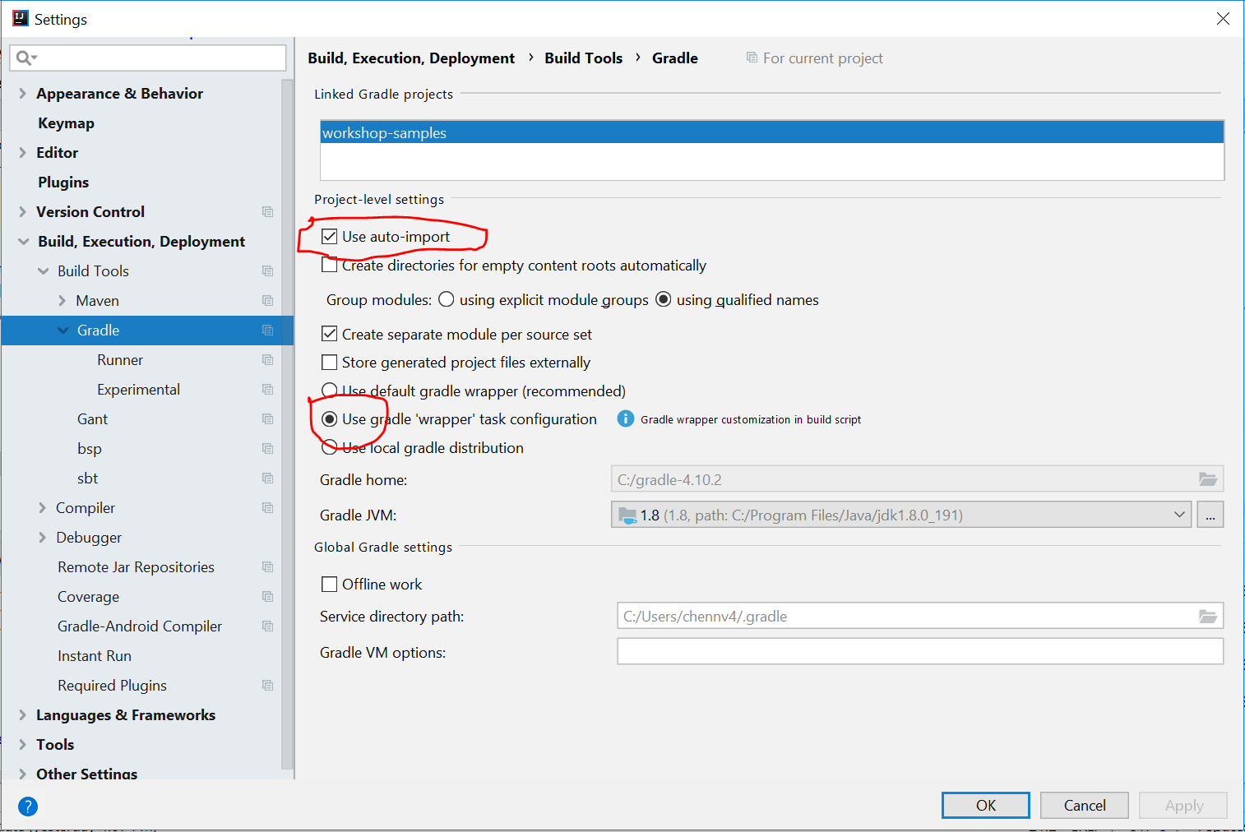
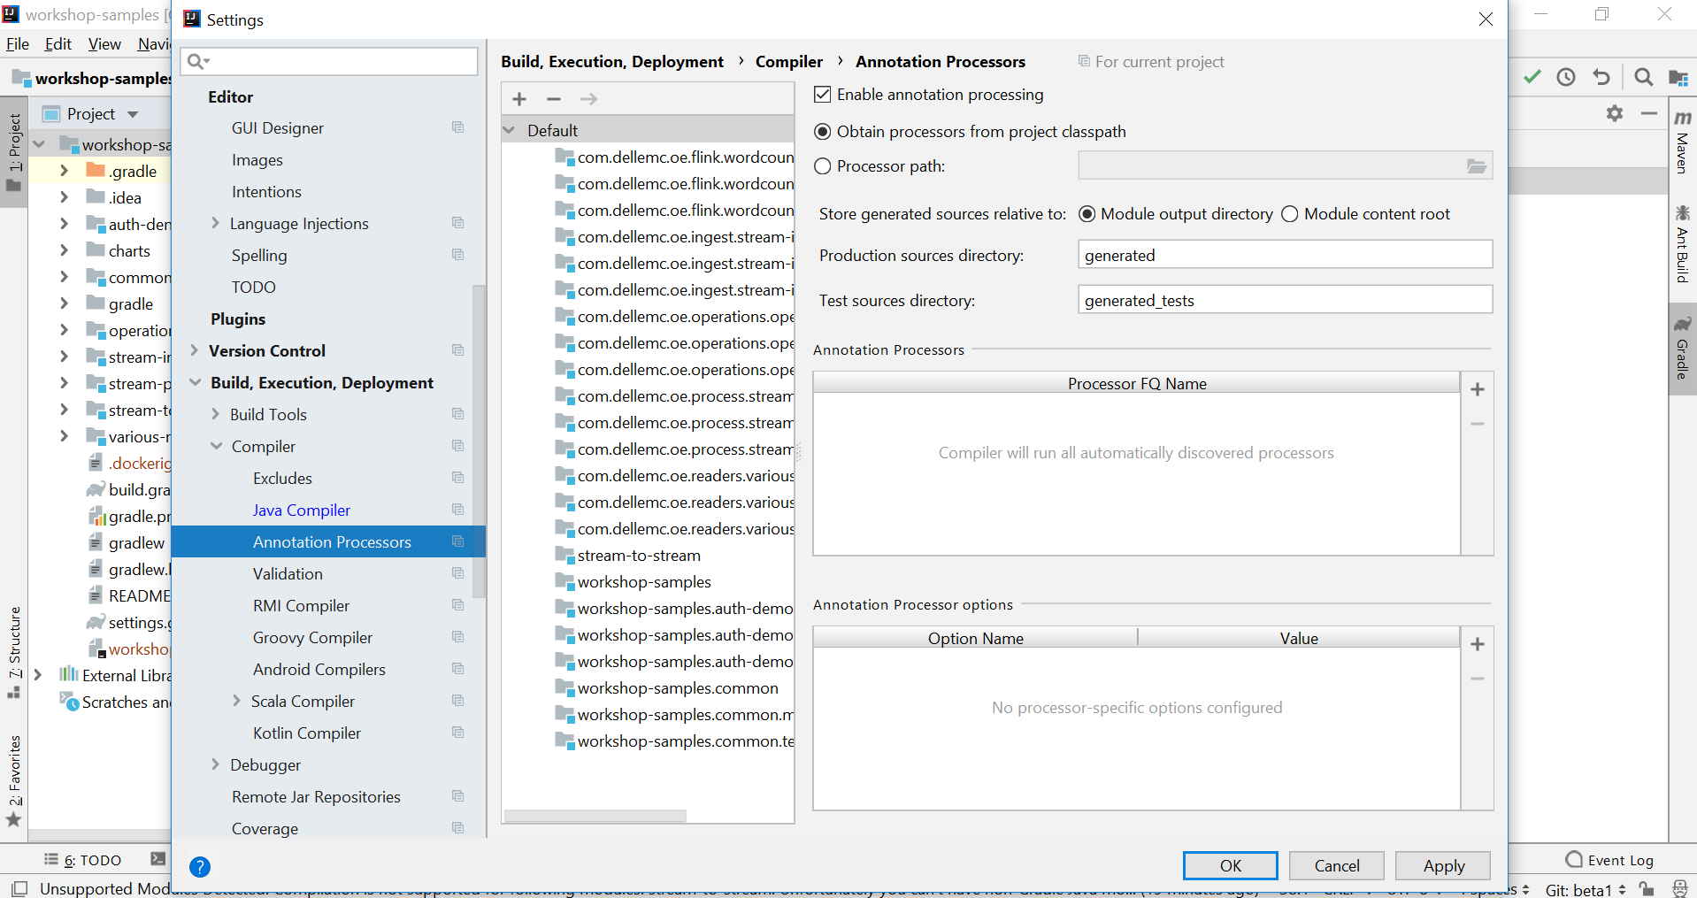
How to setup IDE
Select Project → File → settings → plugins and install Lombok plugin
Select Project → File → settings → Build,Execution,Deployment → Annotation Process
Select Project → File → settings → Build Tools → Gradle

Slide 8
Modify the deployment configuration – docker-compose.yml
Most likely only need to change the network related parameters, figure out one available HOST IP（do not use 127.0.0.1）
Services
Pravega
environment:
HOST_IP: 192.168.188.130
mqttwriter:
environment:
MQTT_BROKER_URL: tcp://192.168.188.130:1883
pravegagw:
environment:
PRAVEGA_CONTROLLER: tcp://192.168.188.130:9090
MQTT_BROKER_URL: tcp://192.168.188.130:1883
Grafana
./Visualization/Config/influxdb-datasource.yaml
url: http://192.168.188.130:8086

Slide 9

Local deployment of InfluxDB+Grafana+Pravega+IoT GW
Download the code from github
Go to workdir
cd /home/ubuntu/piedpiper/DistanceCalculation/
Deploy
Run CMD “docker-compose up” OR “docker-compose up –d” (running in the background)
Check the status
docker-compose ps
Un-deploy
docker-compose down

Slide 10
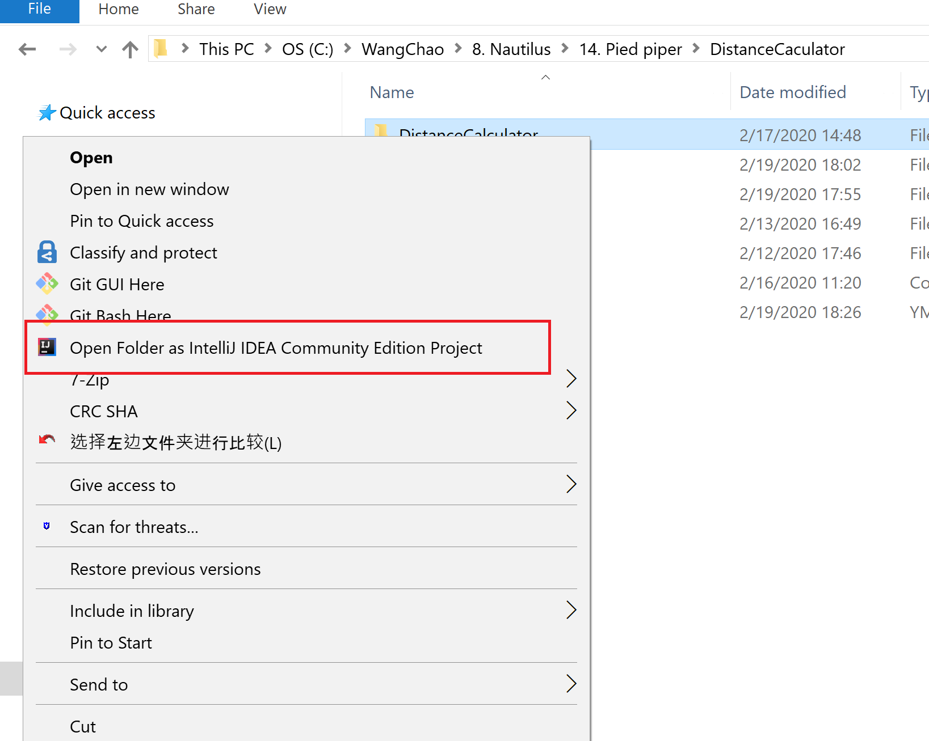
Using local IDE to run Flink Distance Calculation Job -（1）
Using IntelliJ IDEA to open the “Flink Distance Calculation” project

Slide 11
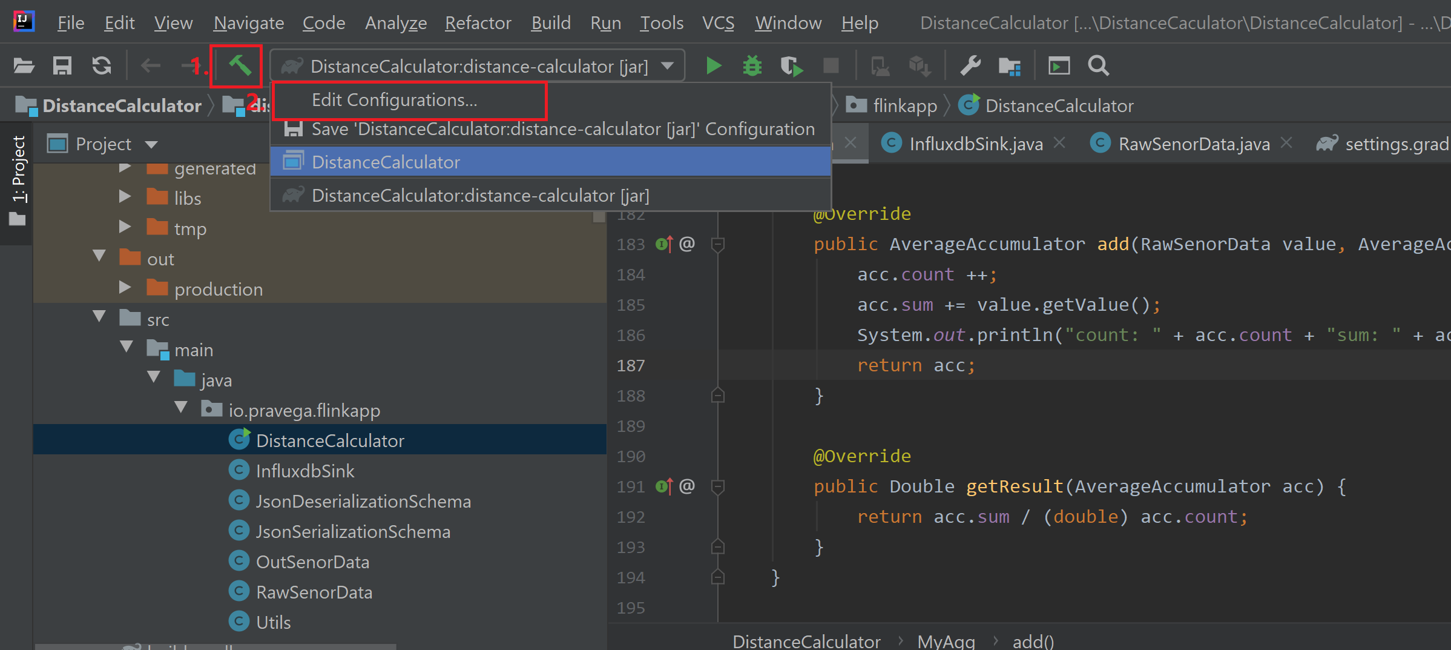
Using local IDE to run Flink Distance Calculation Job -（2）
New a task

Slide 12
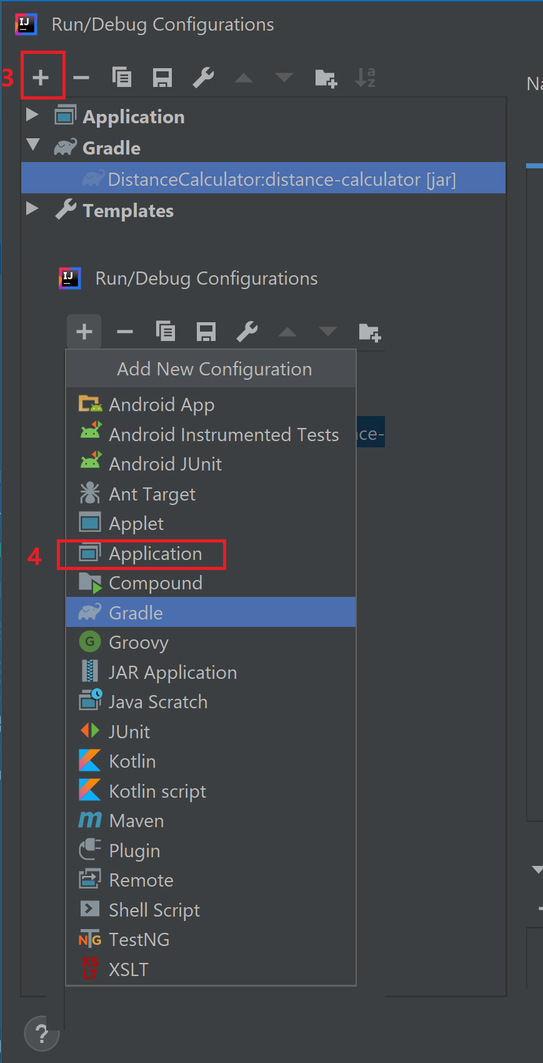
Using local IDE to run Flink Distance Calculation Job -（3）
New a task

Slide 13
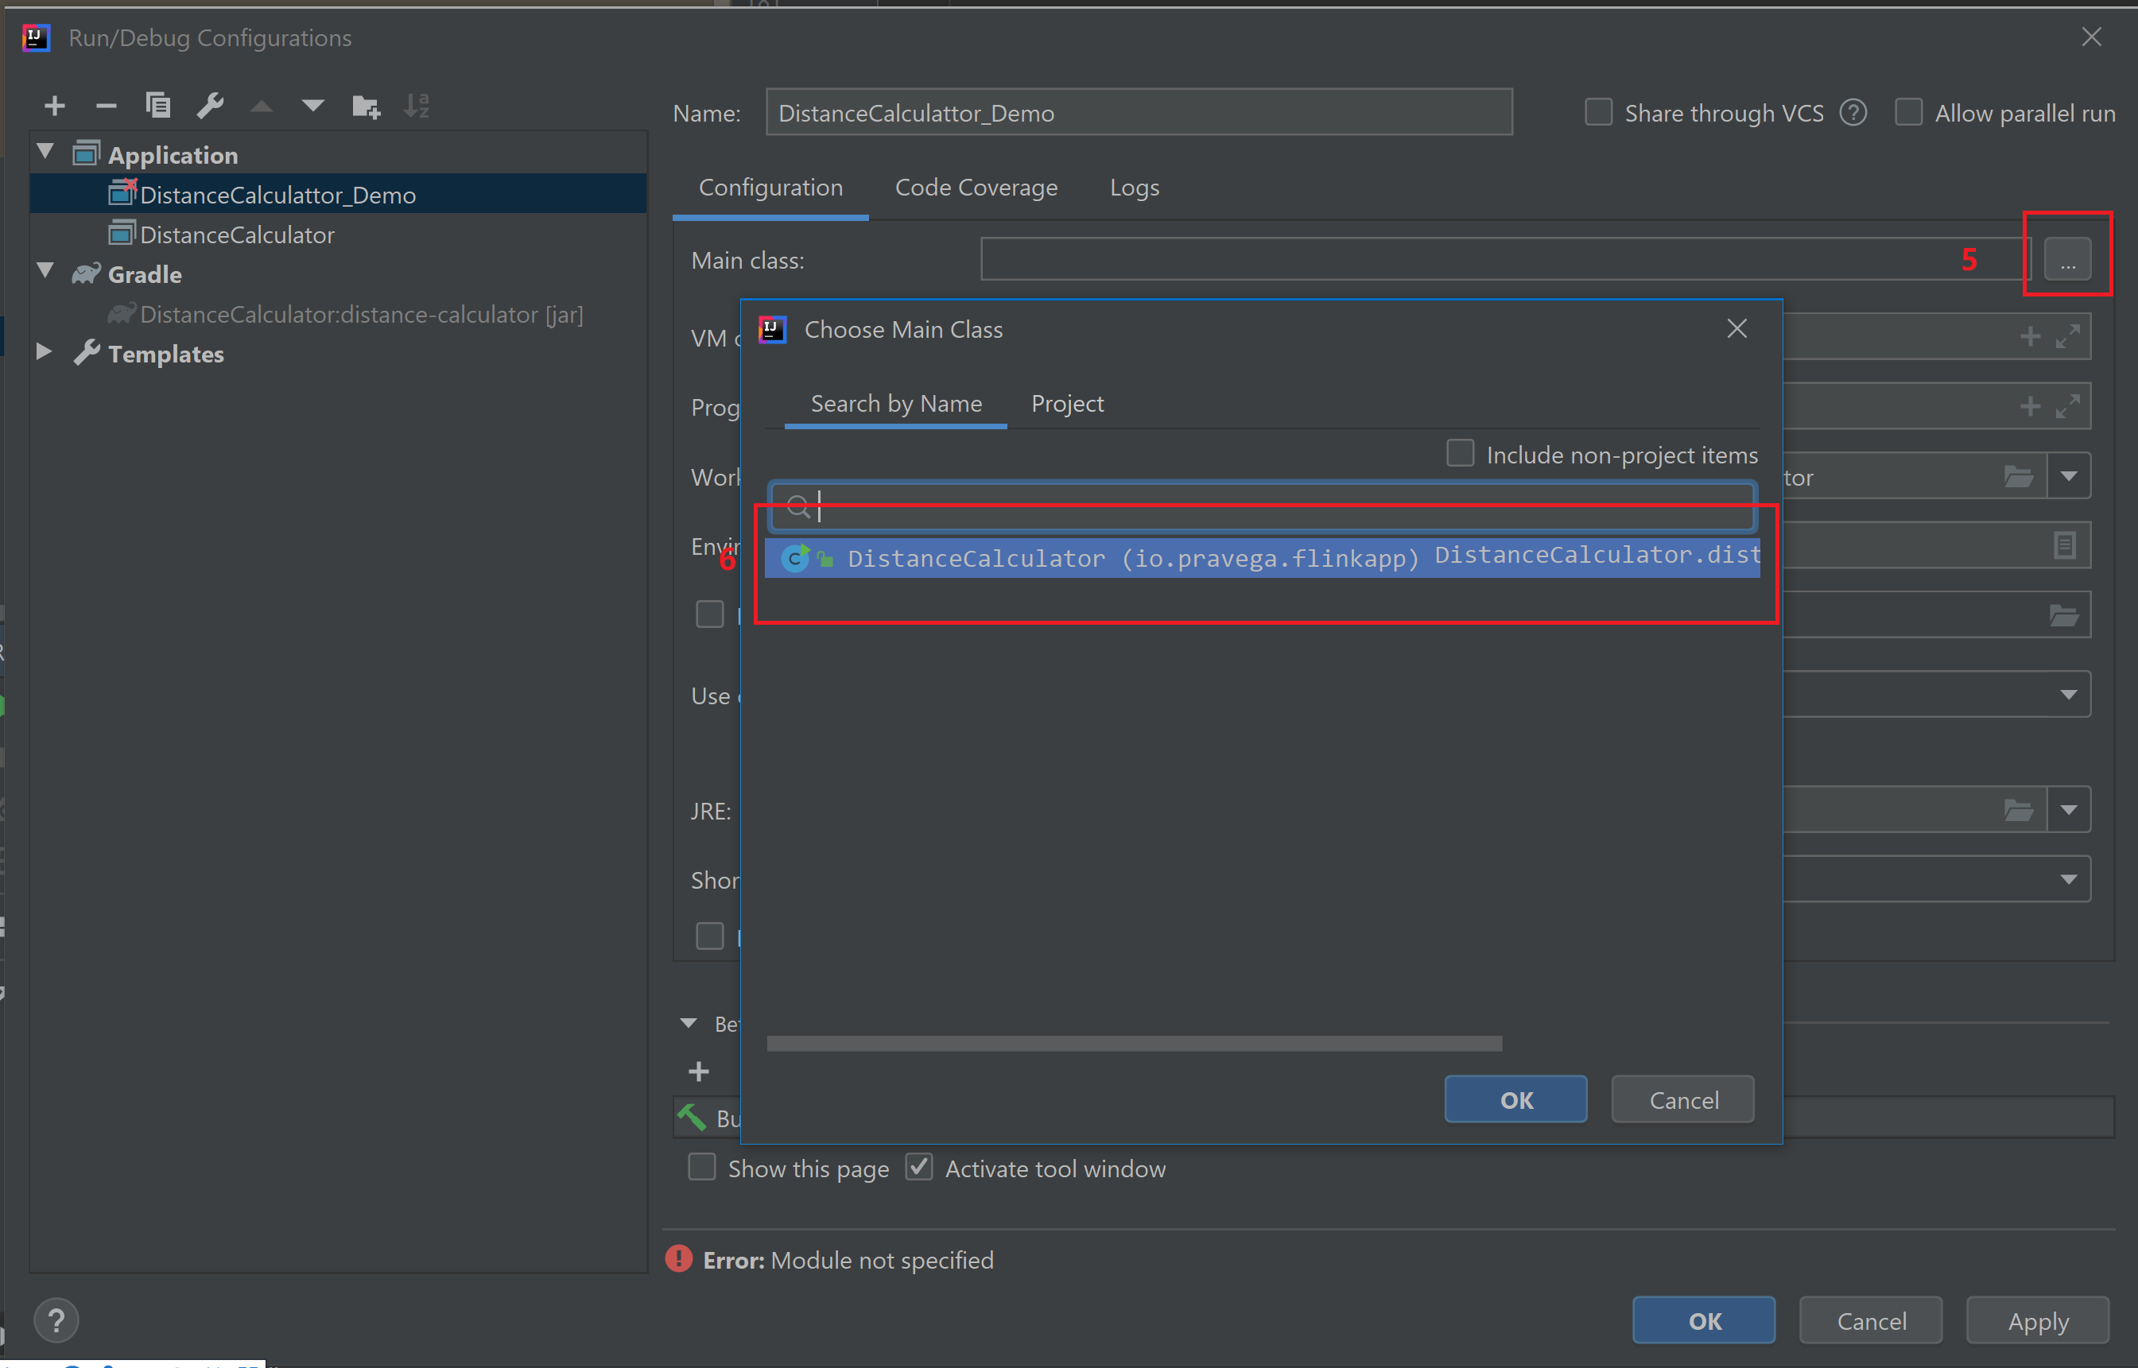
Using local IDE to run Flink Distance Calculation Job -（4）
New a task

Slide 14
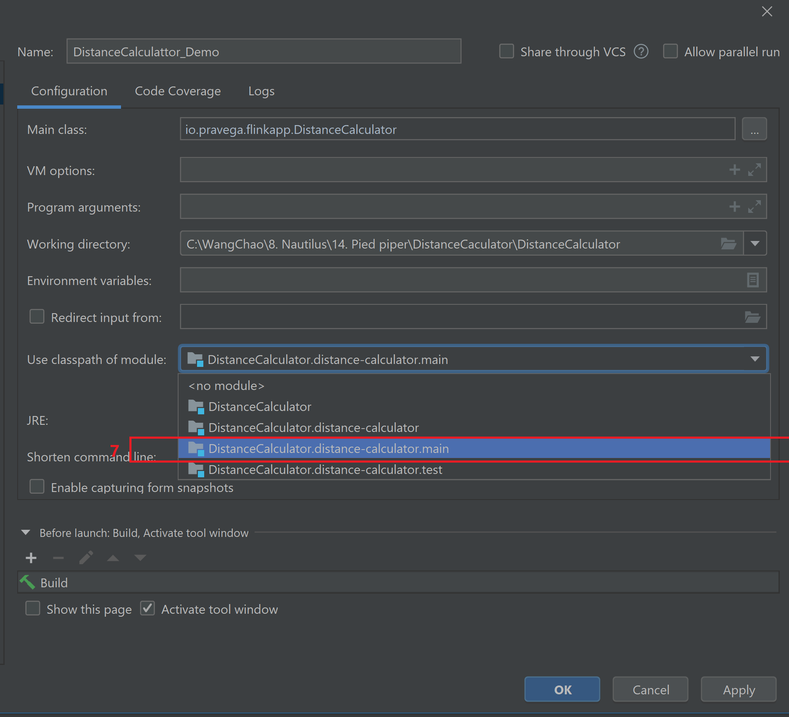
Using local IDE to run Flink Distance Calculation Job -（5）
New a task

Slide 15
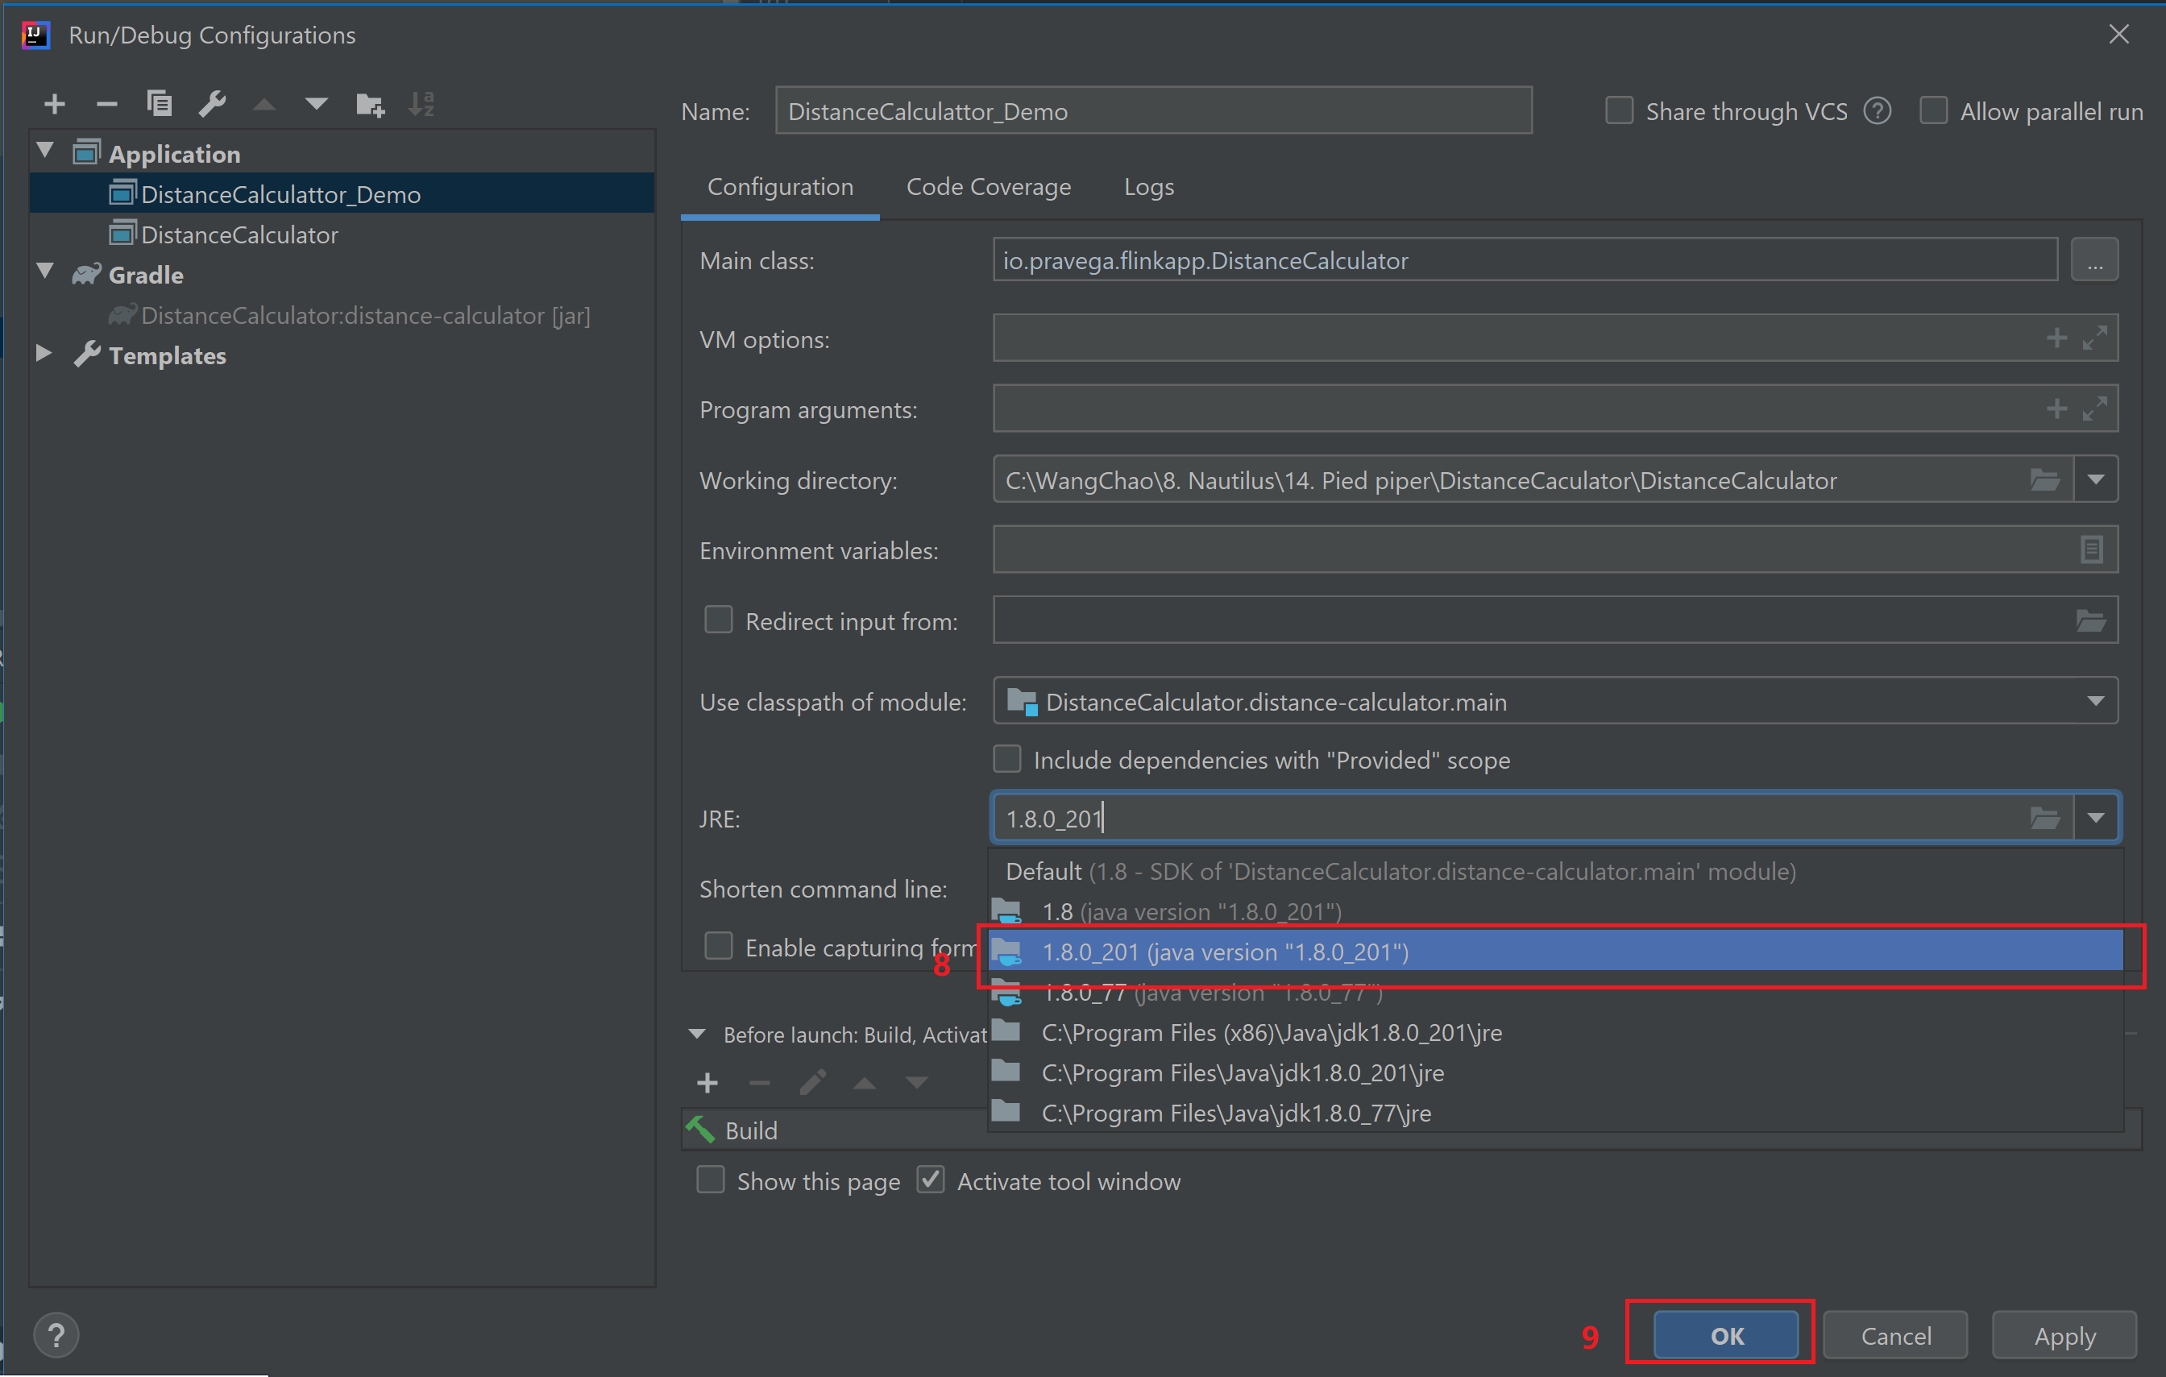
Using local IDE to run Flink Distance Calculation Job -（6）
New a task

Slide 16
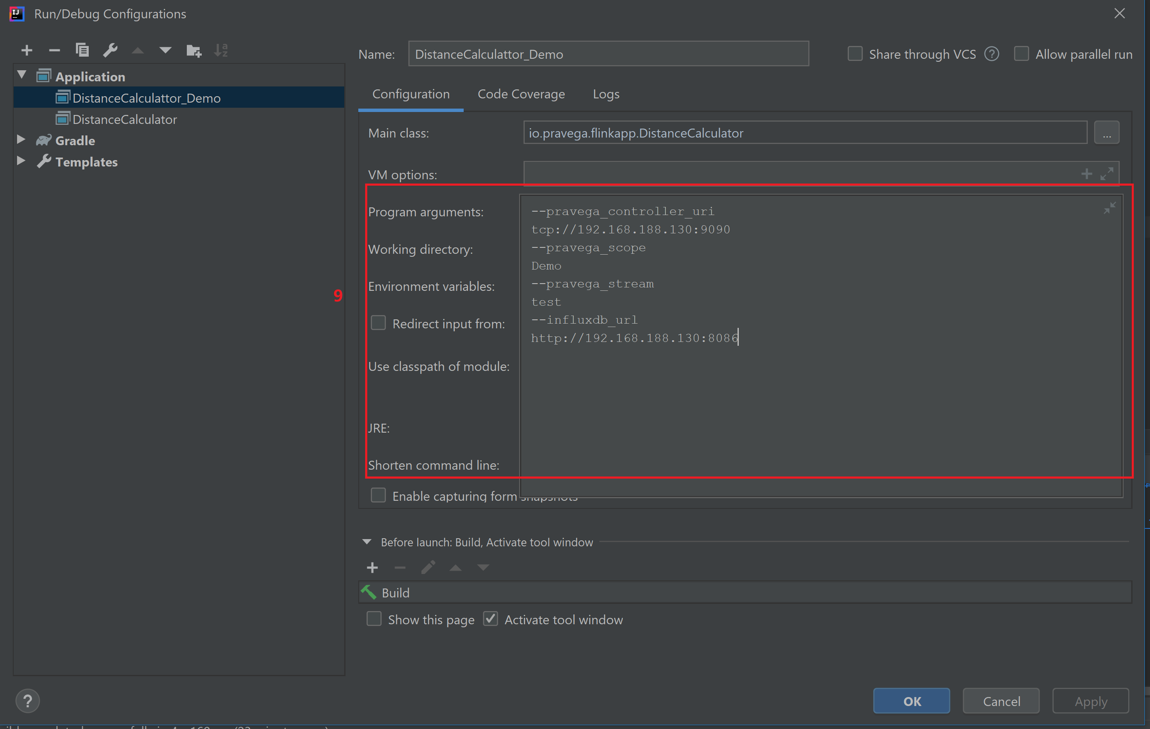
Using local IDE to run Flink Distance Calculation Job -（7）
New a task

Slide 17
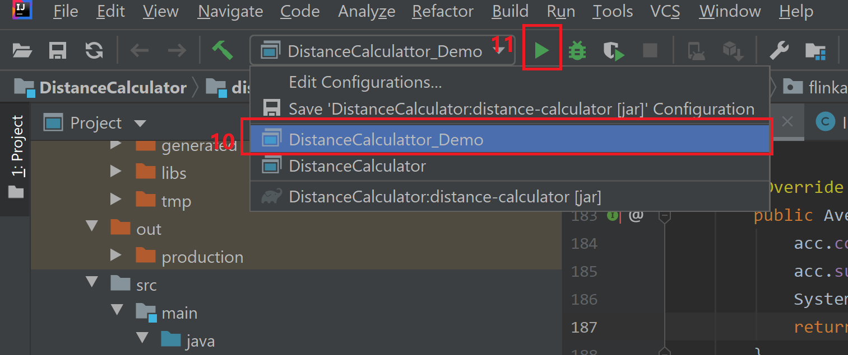
Using local IDE to run Flink Distance Calculation Job -（8）
Run that task

Slide 18
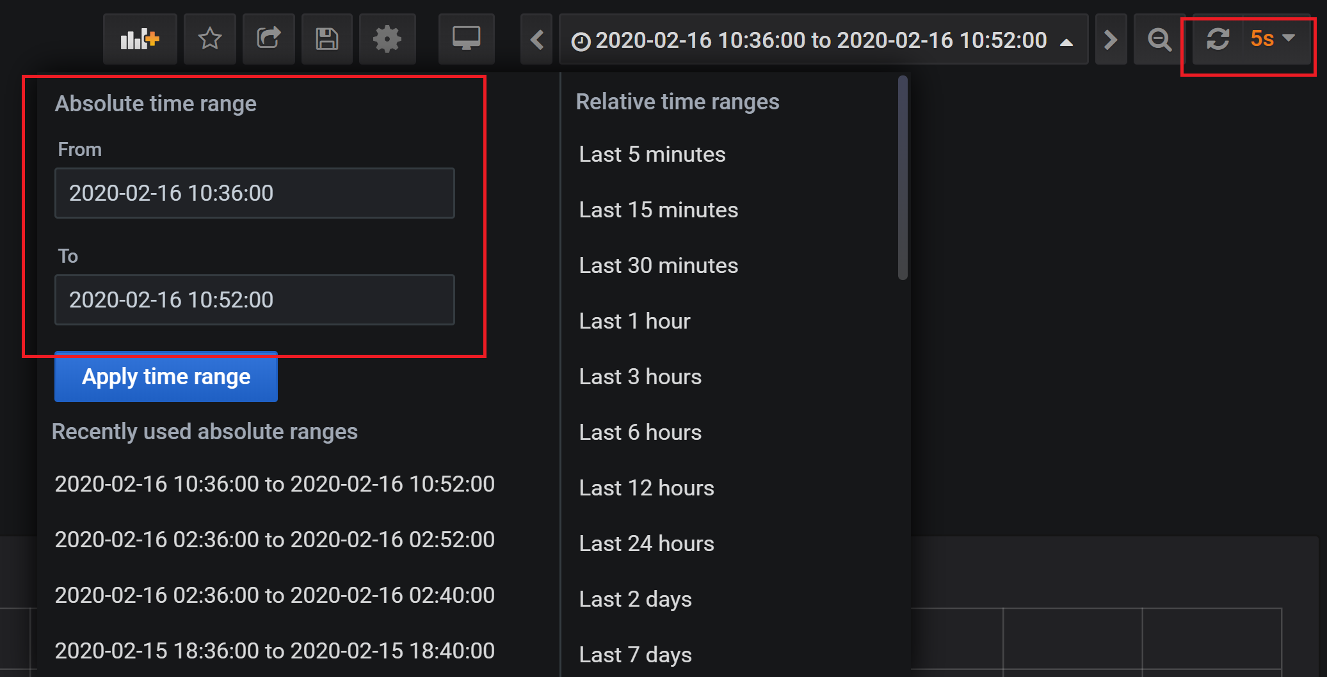
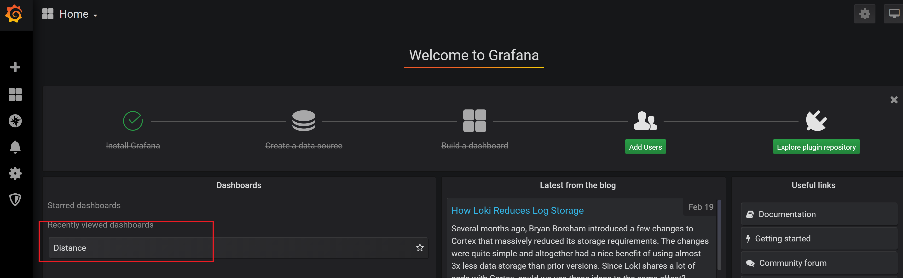
Open the Grafana to present the result
Present the result
Login to http://<Host IP>:3000，Open Grafana dashboard，select the dashboard“Distance”
Optional：modify the time range and refresh sequence if using the simulator to generate the data
OR directly access http://<Host IP>:3000/d/7jAI6_-Wk/distance?orgId=1&from=1581820530000&to=1581821760000&refresh=5s
Username/Password：admin/password

Slide 19
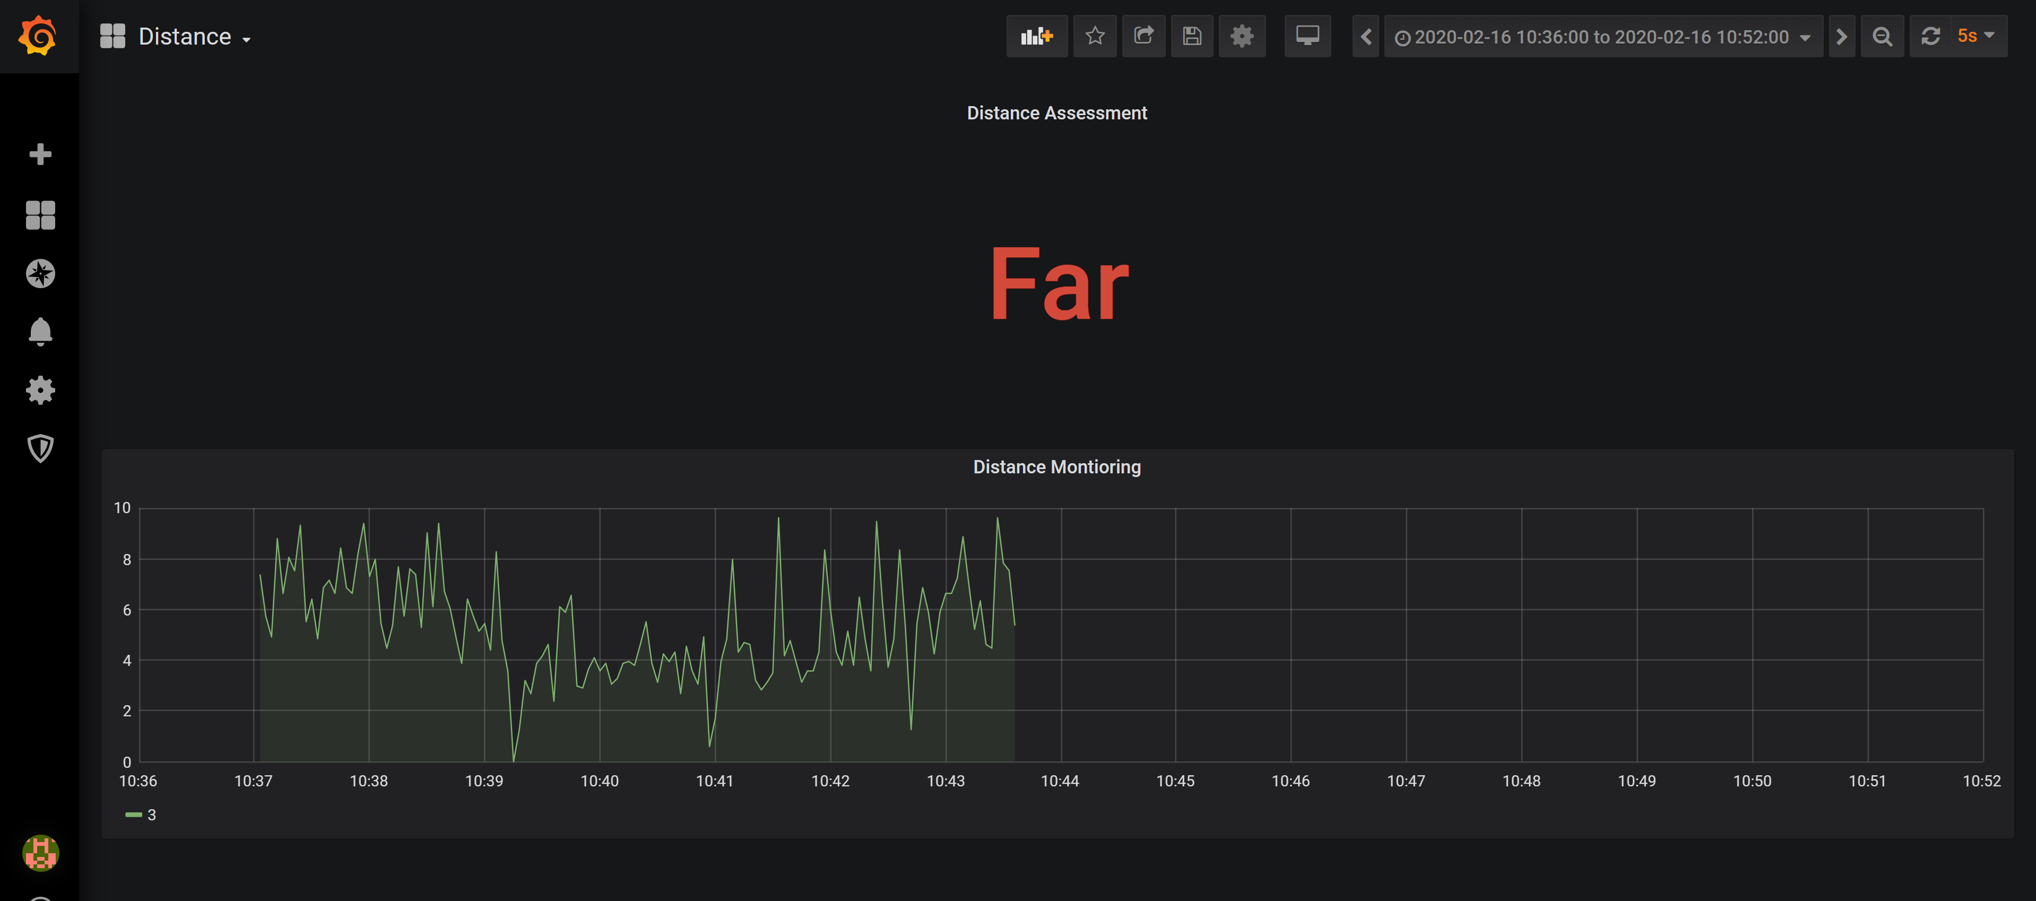
Screenshot of Grafana

Slide 20
Deploy a local Fink cluster
Download the deployment files
git clone https://github.com/docker-flink/examples.git
cd ./examples
Deploy Flink cluster
docker-compose up
OR
Deploy Flink cluster in the background
docker-compose up -d
TaskManagers scale in/out
docker-compose scale taskmanager=<N>
undeploy the cluster
docker-compose kill/docker-compose down
Notes:
Usage
Launch a cluster in the foreground
docker-compose up
Launch a cluster in the background
docker-compose up -d
Scale the cluster up or down to N TaskManagers
docker-compose scale taskmanager=<N>
Kill the cluster
docker-compose kill
When the cluster is running, you can visit the web UI at http://localhost:8081. You can also use the web UI to submit a job to a session cluster.
To submit a job to a session cluster via the command line, you must copy the JAR to the JobManager container and submit the job from there.
For example:
$ JOBMANAGER_CONTAINER=$(docker ps --filter name=jobmanager --format={{.ID}}) $ docker cp path/to/jar "$JOBMANAGER_CONTAINER":/job.jar $ docker exec -t -i "$JOBMANAGER_CONTAINER" flink run /job.jar

Slide 21
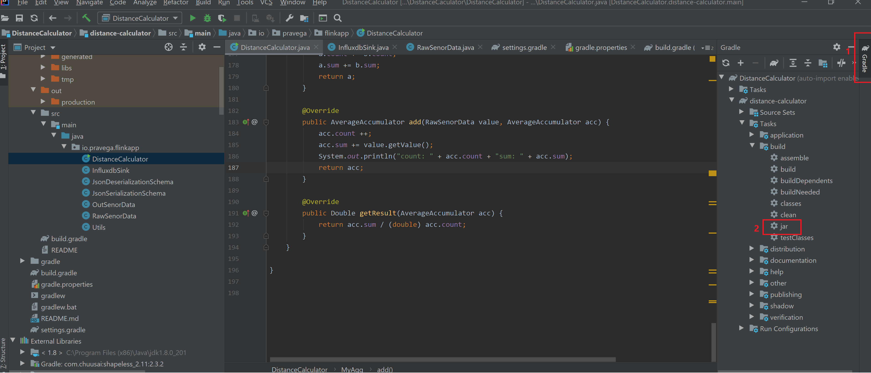
Package Flink Job App - （1）
Rerun Using local IDE to run Flink Distance Calculation Job -（1）
Performing the “jar” task

Slide 22
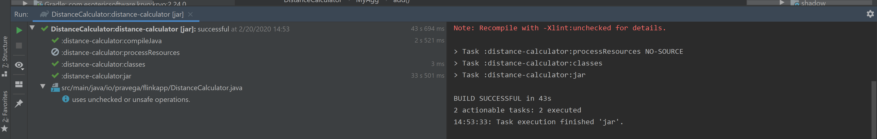
Package Flink Job App - （2）
After the task run successfully, gain the “distance-calculator-4.0.jar” in this project workDIR “DistanceCalculator\distance-calculator\build\libs”

Slide 23

Upload Flink App into Flink cluster
Login to Flink http://<Host IP >:8081

Slide 24
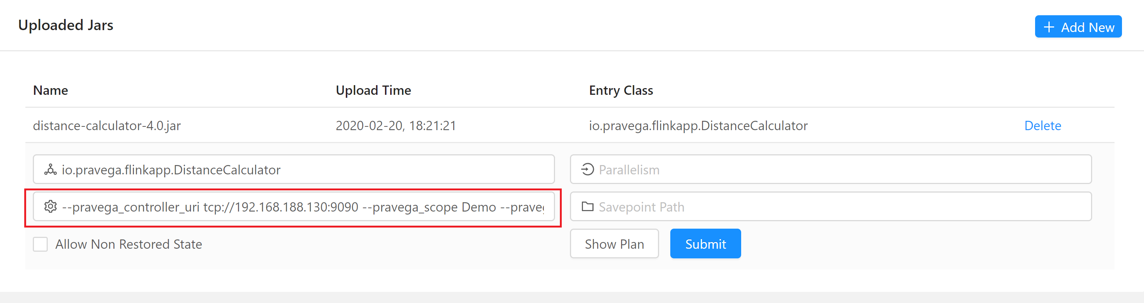
Submit Flink JOB
Fill in the paraments similar with Using local IDE to run Flink Distance Calculation Job -（7）

